Slide 1

Retail Promotion Configuration Service
End of Studies Project
Presented by :
Mohamed BELLAKHAL
School supervisor
Mr. Mohamed Bécha Kâaniche
Academic year:
2020/2021
Company supervisors:
Mr. Zied BELLIL
Mr. Ghaieth ZOUAGHI

Slide 2
AGENDA
PROJECT CONTEXT
PROJECT GOAL
PROJECT REQUIREMENTS
SYSTEM DESIGN
IMPLEMENTATION
DEMONSTRATION
CONCLUSION & PERSPECTIVES

Slide 3

PROJECT CONTEXT
c

Slide 4
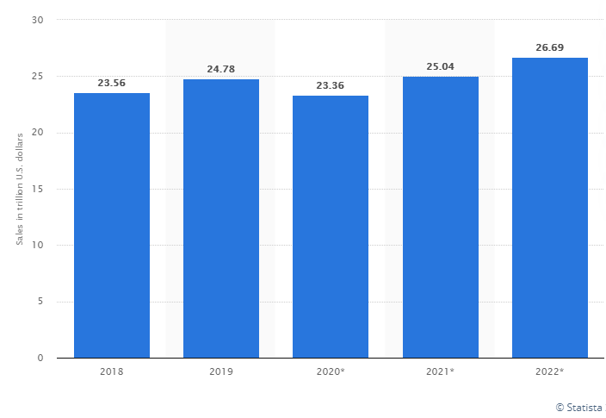
Retail promotion management and data, how is it going so far?
Worth projected at 26.7 Trillion $ for 2022.
A Competitive industry.
Promotions are fundamental.
Customer behaviour affects promotions outcome.
Data is the key to improve promotion planning.

Slide 5


Retail promotion management and monolithic applications
User
Exponential growth of data generated by clients.
Traditional retail application structure.
A single and indivisible unit.
Slow response time, development time and dependency conflicts.
Not scalable nor flexible.
Monolithic retail application
Application module
Application module
Application module

Slide 6
SOAs and WOAs, are they enough for retail?
User
Application division by enterprise.
Scalable and reusable.
Favor common standards.
CI/CD and DevOps are not mainstream.
Scalable but not flexible.
Enterprise application
Enterprise application

Slide 7

Microservices and retail? A real game changer
User
.
Highly maintainable, testable, loosely coupled and independently deployable.
Lower the barrier to innovation.
Reliable, replaceable and scalable.
Scalable and flexible.
Retail application
Microservice
Microservice
Microservice

Slide 8
Microservices and configuration handling
User
High need for configuration.
Large number of configuration requests between the microservices.
Delay in responses.
Conflicts within the application.
Retail application
Microservice
Microservice
Microservice

Slide 9
PROJECT GOAL

Slide 10
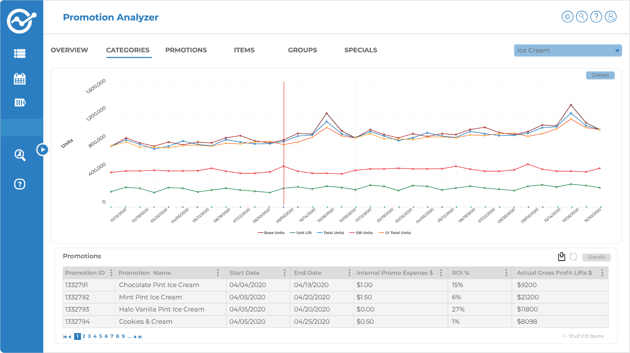
Cognira
Founded in 2015 in Atlanta, US.
A promotion management solution for retailers.
An architecture based around microservices.
Cognira is scaling fast.
Configuration handling is not.
©cognira.com

Slide 11
The retail promotion configuration service
A standalone microservice that answers all the needs for configuration.
Transform the configuration handling to an automated task.
Optimize the inter-communication between the microservices.
Retail application
User
Configuration Handler
Microservice
Microservice
Microservice

Slide 12
PROJECT REQUIREMENTS

Slide 13
Functional requirements
(1/2)
Configuration automation :
Automated pipeline for configuration editing
Discard direct access to the database.
Configuration versioning :
Add version to configuration files.
Export configuration files to the cloud.
Configuration handling :
Integrate with the promotion management application.
Handle requests for configuration data.

Slide 14
Functional requirements
(2/2)
Configuration logging :
Generate logs for the edit type.
Generate logs for the edit time.
Testing:
Testing scenarios.
Test the performance.
Containerization and deployment :
Package the microservice.
Create a deployment pipeline.

Slide 15
Non-functional
requirements
Security :
Secure the access to the microservice.
Secure the configuration data.
Data fidelity:
Reliable configuration data.
Performance:
Optimal response time.
Optimal resources usage.
Reusability
The microservice can be integrated in a similar business case.

Slide 16
System Design

Slide 17
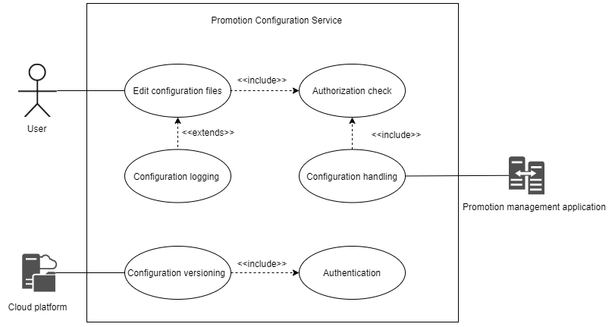
Use-case analysis

Slide 18


System design
User
REST APIs
Promotion Management Application
REST APIs
Backend application
Database queries
Data processing
Database
Configuration Handling Microservice
Data Lake

Slide 19
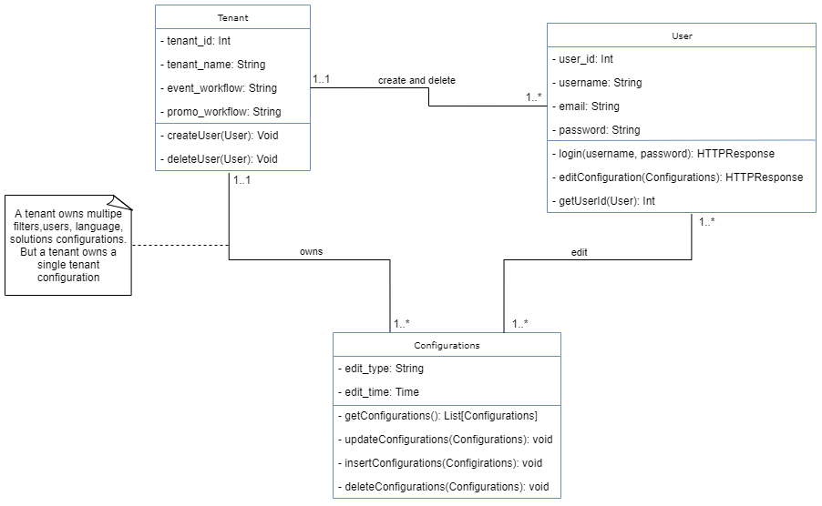
Data modeling (1/3): the strategy design pattern

Slide 20
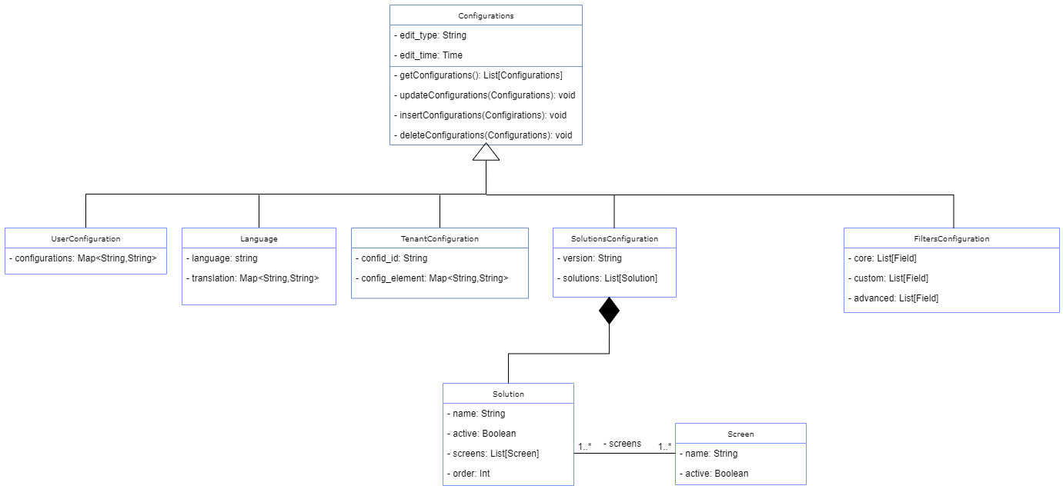
Data modeling (2/3): the strategy design pattern (cont’d)

Slide 21
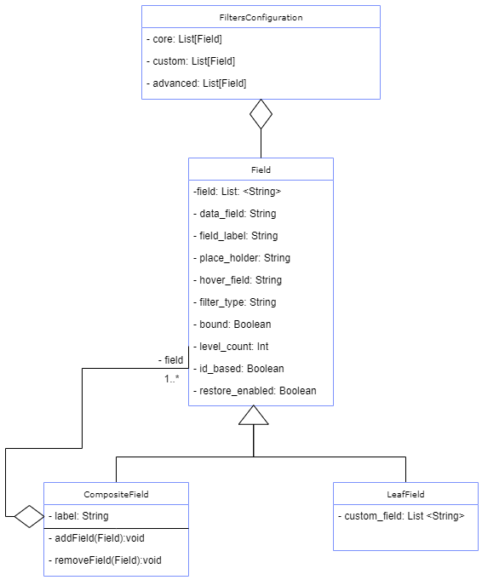
Data modeling (3/3): the composite design pattern
Composite Field
Composite Field
Leaf Field
Leaf Field
Composite Field
Leaf Field

Slide 22







Technological choices
Back end:
  Scala
  Akka-http
Data processing:
  Apache Spark
  Azure data lake
Containerization and deployment:
  Docker
  Kubernetes
Database:
  Apache Cassandra

Slide 23
IMPLEMENTATION

Slide 24
The configuration automation APIs
Developed APIs with abilities to add, retrieve, insert, update and delete configuration data.
Developed and performed unit tests and integration tests for each developed API.
CQL queries
Configuration Handler
Database server

Slide 25

Versioning and exporting configuration files to Azure
Pushing the configuration data is done through a CronJob.
The CronJob allows to run spark instructions on clusters and monitor their status.
Spark cronjob
Configuration files
Cassandra database
Configuration Handler
Azure data lake

Slide 26




Dockerizing and deploying the microservice
Added the necessary docker files to package the backend application into a Docker image.
Uploaded the docker image into the container registry.
Deployed the application on a minikube cluster.
Docker image
Docker image
Configuration Handler
Docker files
Kubernetes cluster
Container Registry

Slide 27
DEMO

Slide 28

Demo

Slide 29
CONCLUSION & PERSPECTIVES

Slide 30
Conclusion
Pros:
A smooth configuration experience
Performance optimization
Configuration automation
Cons
Resources vs performance trade-off
REST APIs

Slide 31
Perspectives
Alternative approaches:
RedHat multi-tenancy approach: A new database server for each configuration set.
ConfigMap APIs: all the data is loaded at startup time
Prospects
Take the best of each approach.
Go Saas with the configuration service.
Build a dashboard for logging and version tracking.

Slide 32
THANK YOU !

Slide 33
Retail promotion management, SOAs and WOAs
User
Exponential growth of data generated by clients.
Traditional retail application structure.
A single and indivisible unit.
Slow response time, development time and dependency conflicts.
WOA application
Application module
Application module
Application module

Slide 34
Configuration handling (1/2): The old promotion management application architecture
The promotion management application
Requests between the back end microservices for configuration data
A saturated database server
Back end microservice
Back end microservice
Database server
Back end microservice

Slide 35
Configuration handling (2/2): The integration of the promotion application configuration service
The promotion management application
Requests for configuration data go only the the promotion application configuration service
Optimized requests and a single connection to the database server
Configuration handler
Database server

Slide 36
Data modeling (1/2): a general overview
Configuration tables:
Filters configuration
Tenant configuration
Solution configuration
Language configuration
User configuration

Slide 37
Data modeling (2/2): configuration tables
Configuration data
Configuration table
Table version
Logging data
Edit information

Slide 38
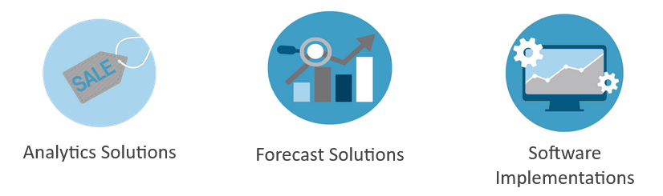
Cognira
Founded in 2015 in Atlanta, US, with offices in Tunis,TUN and Lille, FR with 70 employees.
Recognized two times as one of the fastest growing companies in the Americas according to The Financial Times (Ranked 9 among all the technology companies).
Leading provider in AI powered software for retailers around the world.
Cognira offers the following services for its clients:
Notes:
It shouldn’t come as a surprise that business today is heavily reliant on data, especially for retailers. And retailers use data everyday to assess or predict the impact of their business decisions. And one of the ways they can measure such an impact is by monitoring their communities and costumers feedback. However, due to the unstructured nature of that data on various social media and review websites... and here’s where this project presents a soluition to that challenge as it aims to

